Slide 1
Learning Package Presentation
For developers
Very Secret After the Meeting

Slide 2

Learning Outcome
Learn the effectiveness of retrospective
Implement retrospectives into co-operative activities
Understanding the techniques used in retrospectives

Slide 3


Activity 1
Objective: To fling the ping
Pong ball over the other
Team’s side of the sheet
Rules:
Split into two equal teams
One team on opposite sides of the sheet
Stay at your side of the sheet at all times
Cannot touch the ping pong ball(s).
No physical contact with the other team.

Slide 4

Activity 1 - cont.
How are you feel about this activity?
You think your team could do better?

Slide 5
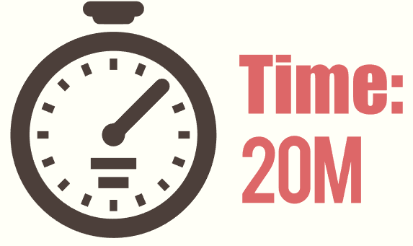

Activity 1 - cont.
Round 2 - Attempt to best the other team. This time, more ping pong balls MAY be included

Slide 6
Review and Feedback
How well did the 5 minutes of discussing a team plan go?
How much did the discussion affect the activity?
Was your team’s performance improved after the discussion?

Slide 7

Activity 2
Objective: Keep ping pong balls from touching the ground and get more ping pong balls being hit up by using ping pong paddles
Rules :
Cannot hit a ping pong ball consecutively.
A ball will be added in with each 2 minutes.
Cannot touch/hold the ping pong balls.
Everyone must stand in a circle
Cannot move from your position and break the circle.

Slide 8

Activity 2 - cont.

Slide 9

What is Retrospective
Retrospectives are team meetings held at the end of a Sprint to provide clarity on :
What went well,
What didn’t go so well, and
What can be improved for next iteration.

Slide 10

Who Participates in a Retrospective
The entire team Should participate in a Retrospective.
Fail to participate in a retrospective results to unheard opinions to improve performance for the next sprint

Slide 11
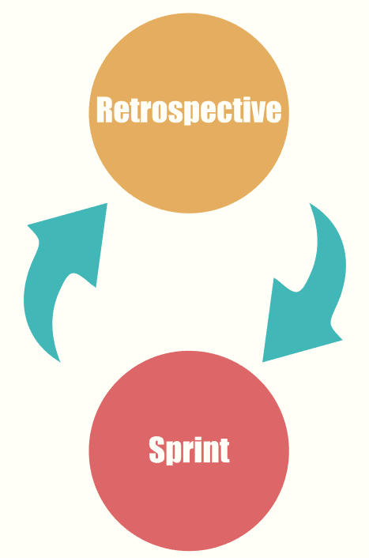
When to Hold a Retrospective
A retrospective should be held after a sprint and before the next sprint.
A retrospective should improve the process of the next sprint

Slide 12
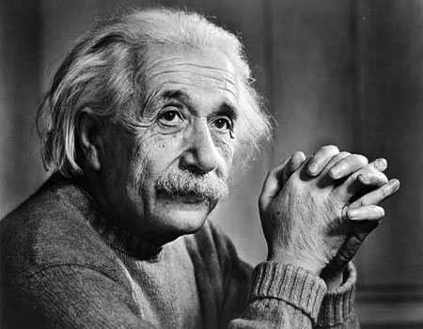
Insanity: Doing the same thing over and over again and expecting different results ~ Albert Einstein

Slide 13
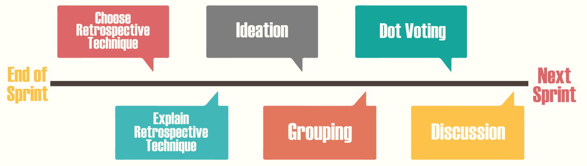
Retrospective Process
The process of retrospective depends on the team. Each project team should have a standardized process. New teams can follow this process for effective retrospective.

Slide 14
Process - Choosing a retrospective technique
There are many retrospective techniques the team can use: - Liked, Learned, Lacked, and Longed for. - Sad, Mad, and Glad - Start, Stop, and Continue
Each technique focuses on specific factors towards the project, either towards the project’s process or towards personal behaviour.

Slide 15

Liked, Learned, Lacked, Longed for
A factual retrospective technique.
Focuses on the project’s process.
- What the team “Liked” about the process. - What the team “Learned” from the process. - What the process “Lacks” - What the team “Longed for” in the process.

Slide 16

Sad, Mad, Glad
An emotional Retrospective technique.
Focuses on individual team member’s emotions towards the process or towards their perspective towards other’s working habits
What process/teamwork makes the team member “Sad”, “Mad” or “Glad”.

Slide 17

Start, Stop, Continue
An action-based retrospective technique
Focuses on the process or personal actions.
- What should I/the team should “Start” doing? - What should I/the team should “Stop” doing? - What should I/the team should “Continue” doing?

Slide 18
Process - Explain the reason of choosing a technique
There should be a reason for a team to choose a specific retrospective technique.
A technique can be more suitable than the others depending on what has happened during the last process/sprint.
Perhaps people can vote on which technique to use?
Gives an opportunity of the team to familiarise themselves with the selected technique
This step is optional

Slide 19
Process - Ideation
Ideation gives each individual the opportunity to write their ideas about the previous sprint.
Give everyone a piece of paper or sticky notes to write their ideas on.
This is a private process. Each individual should not communicate with each other until this process is complete.
Reduces bias towards an idea
Anonymous (unless an individual wants to be recognized)

Slide 20
Process - Grouping
The team collaborate with each other by grouping common ideas together
Remember Ideation is done individually and privately?
Gives the opportunity for the team to participate in a team environment
Can be fun if the team allows it to.

Slide 21
Process - Dot Voting
Prioritizing ideas - Dot Voting allows each individual to vote on the ideas they are interested in or want to discuss.
Similar to the Ideation process, Dot Voting is done independently
Each person is given a limit of x votes (preferably 5)
Each person is allowed to vote on the same idea more than once
A priority list will be generated based on the amount of votes on a specific idea. More votes = higher priority

Slide 22
Process - Discussion
Create action points to improve on the next sprint/process
Everyone should have their say during this process
Each idea should be discussed one at a time.
The order of ideas are based on their priority, generated by the Dot Voting process
Not all ideas can be discussed. Hence the reason for prioritizing ideas

Slide 23

Retrospective
You have 1 hour to run a retrospective with your team.
Use this time to go through the process of a retrospective for the second activity.

Slide 24
Activity 2 - cont.
Round 2 - Attempt to beat your score from the previous round

Slide 25
Reflective Summary - Activities
Did the team perform better after the retrospective process?
What are some ideas that helped the team improve, if any?
Will you include retrospectives with other projects? Why?

Slide 26

Online Retrospective Tools
Retrium provides a built-in feature to assist the project team to run a retrospective
Project groups are becoming dispersed.
People do not have the time for travel, making it near to impossible for retrospectives
Online tools such as Retrium can be used to collaborate with the team and run a retrospective online
Recommended to run with internet calling such as skype

Slide 27
Extra Readings
Mountain Goat Software. (n.d). Sprint Retrospective. Retrieved from https://www.mountaingoatsoftware.com/agile/scrum/sprint-retrospective
J, Skeels. (2013, April 22). AgencyAgile Tips for Running a High-Impact Retrospective. Retrieved from http://agencyagile.com/small-agency-agile-5-tips-for-running-a-high-impact-retrospective/
M, Ledalla. (2016, April 24). Techniques for Keeping Retrospectives Lively. Retrieved from https://www.scrumalliance.org/community/articles/2014/april/a-reflection-on-retrospectives
L, Gonçalves & B, Linders. (n.d.). Doing Valuable Agile Retrospectives. Retrieved from
http://www.methodsandtools.com/archive/agileretrospective.php
Retrium: https://www.retrium.com/

